Slide 1






U.S. Airline On-Time Performance Database
January – June 2026
DATA 201 DBMS Group Project
Group members: Charishma, Swathi, Priyanka, WILLIAM
Source: U.S. Department of Transportation, Bureau of Transportation Statistics

Slide 2

Dataset Introduction
Source: U.S. Department of Transportation, Bureau of Transportation Statistics
Dataset: Reporting Carrier On-Time Performance
Period: January–June 2026
Monthly files combined: 6
Total flight records: 3506809
Raw attributes: 101
Each row represents a reported flight

Slide 3

Why We Chose This Dataset?
This dataset was selected because it:
Represents a real-world transportation system.
Contains more than 3.4 million flight-level records.
Supports airline, airport, route, and monthly comparisons.
Includes operational details and performance measures.
Requires data cleaning and normalization before database implementation.
Supports basic and advanced SQL queries.
Questions our database will answer:
Which airlines have the best departure and arrival on-time performance?
Which airports and routes experience the most delays?
What are the most common causes of delays?
How do cancellations and diversions vary by airline and month?

Slide 4
Dataset Complexity
Data Preparation and Cleaning Needs
Combine six monthly files with consistent column structures.
Normalize repeated airline, airport, route, and date information.
Convert blank values to NULL rather than treating them as zero.
Preserve negative delays because they represent early departures or arrivals.
Convert FL_DATE, which includes a time portion, into a proper date value.
Standardize scheduled time fields such as 0600 and 0915.
Interpret CANCELLED and DIVERTED as binary indicators.
Preserve NULL delay-cause values when a specific cause did not apply.
Handle diversion-summary fields, which may be NULL for non-diverted flights.

Slide 5
Columns Used for the Database
Data area | Examples | Purpose
Date | FL_DATE, YEAR, QUARTER, MONTH, DAY_OF_MONTH, DAY_OF_WEEK | Monthly and date analysis
Airline | OP_UNIQUE_CARRIER, OP_CARRIER_AIRLINE_ID | Airline comparisons
Airport | ORIGIN, DEST, airport IDs, cities, states | Airport and route analysis
Route | Origin airport, destination airport, DISTANCE | Route-distance analysis
Flight | Generated FlightID, flight number, tail number | Flight identification
Performance | Scheduled/actual times, delays, taxi times, elapsed times | On-time performance
Status | CANCELLED, CANCELLATION_CODE, DIVERTED | Cancellation and diversion analysis
Note: The table shows representative columns by data area.
All 61 source columns are preserved in the staging dataset and mapped to normalized tables.

Slide 6
Schema Design & Database Setup
From raw flight records to a normalized relational database
ER/EER model and relationship design
Relational schema mapping and key structure
Normalization through 3NF
MySQL staging import and validation
Current status: Six monthly files imported
Staging records: 3,506,809

Slide 7
Initial ER Diagram :
The ER model separates :
• Flight operations
• Airlines, airports, and routes
• Dates and performance measures
• Delays, cancellations, and diversions
The model shows how these entities connect through relationship cardinalities.

Slide 8
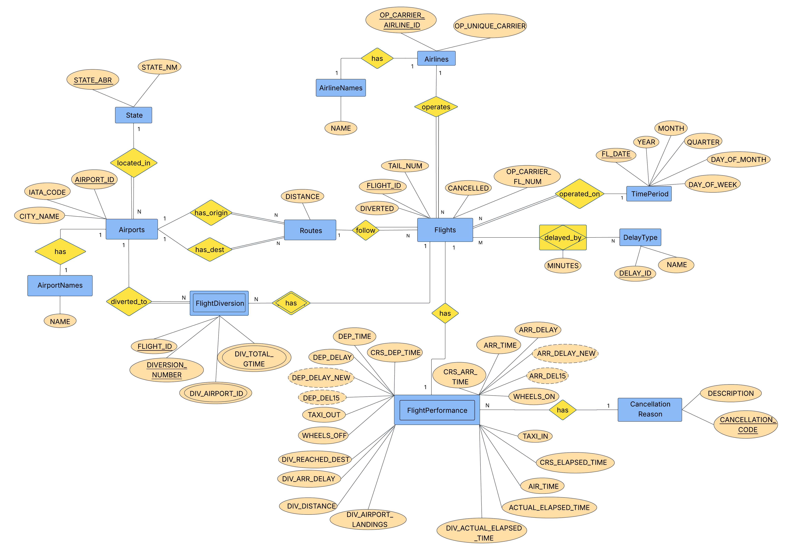
Initial ER/EER Diagram

Slide 9
Relational Schema Mapping
TimePeriod
State
Airlines
AirlineNames
Airports
AirportNames
Routes
Flights
FlightPerformance
DelayType
FlightDelay
CancellationReason
FlightDiversion
The raw staging table will be transformed into these normalized tables.
Generated identifiers such as FLIGHT_ID and ROUTE_ID will be added
during the relational mapping process.

Slide 10
Keys and Relationship Justification
Table | Primary key
TimePeriod | FL_DATE
State | STATE_ABR
Airlines | OP_CARRIER_AIRLINE_ID
Airports | AIRPORT_ID
Routes | ROUTE_ID
Flights | FLIGHT_ID
FlightPerformance | FLIGHT_ID
FlightDelay | FLIGHT_ID + DELAY_ID
FlightDiversion | FLIGHT_ID + DIVERSION_NUMBER
Primary keys uniquely identify records.
Foreign keys connect related tables in the relational schema.

Slide 11
Normalization Through 3NF
Raw BTS data
1NF: Atomic values and one value per field
2NF: Separate flights, routes, airlines, airports, and performance
3NF: Separate states, names, delay types, and cancellation reasons
Normalization reduces repeated information and improves consistency.

Slide 12
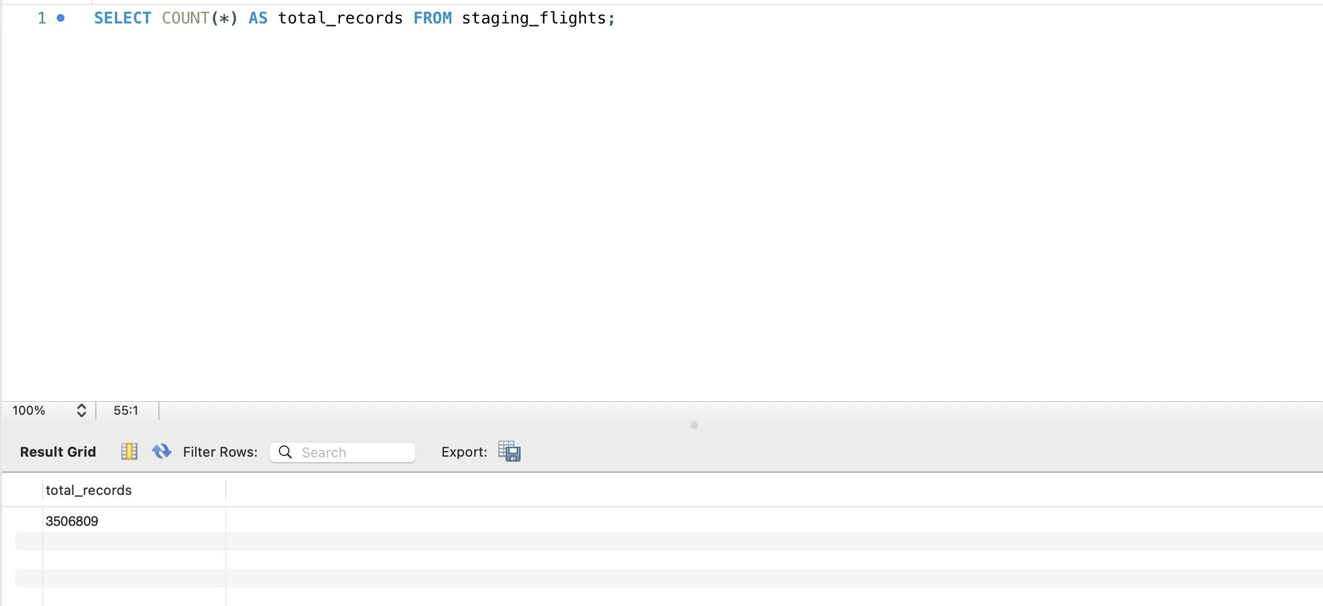
Initial SQL Exploration
• Confirmed that all six-monthly files were imported
• Verified 3,506,809 total records
• Checked monthly row counts
• Examined delays, cancellations, and diversions
• Confirmed that the dataset is suitable for analysis

Slide 13
Basic and Advanced SQL Queries

Slide 14
Challenges & Next Steps
Challenges so far:
Mapping BTS raw column names to normalized table columns
Managing different raw files with 61 columns
Importing and processing more than 3.5 million records
Validating primary-key and foreign-key relationships
Maintaining query performance with a large dataset
Planned improvements for the final project:
Design and test advanced SQL queries
Complete and validate the 13-table normalized database
Prepare dashboards and visualizations
Finalize screenshots, findings, and project documentation

Slide 15


